Slide 1
Encrypt a file Using the Hybrid Encryption (RSA and AES)

Slide 2
Review RSA and AES

Slide 3
RSA key generation : How to solve hard math problems?
e . d ≡ 1 mod Φ(n)
Alice or Bob (good guy) can solve the equation (generate the private key) and other people (bad guy like Oscar) are difficult to solve the equation.
Public key
Private key

Slide 4
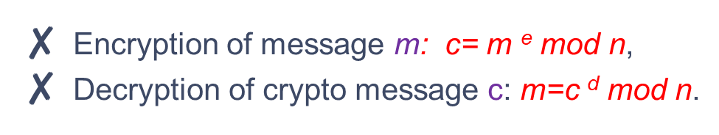
RSA encryption/decryption size
What is the relation between the size of input m (different plaintext messages) and the size of output c (different encrypted messages)?
size of (m)<size of(c)
size of (c) <size of (n)
mod n
size of (m) <size of (n)
We cannot encrypt more than l bits with one RSA encryption, where l is the bit length of n.

Slide 5
RSA encryption/decryption size
Block 1
Block 2
Block 3
Block n
e
Block 1
Block 2
Block 3
Block n
Question: if encrypt a file (1GB), each block size is 512 bits, how many blocks?
1GB=1024MB=1024*1024KB=1024*1024*1024B=1024*1024*1024*8 bits

Slide 6
RSA summary
RSA is the most widely used public-key cryptosystem
RSA is mainly used for key exchange and digital signatures
RSA relies on the fact that it is hard to factorize n
Currently 1024-bit cannot be factored, but progress in factorization could bring this into reach within 10-15 years. Hence, RSA with a 2048 or 3076 bit modulus should be used for long-term security

Slide 7
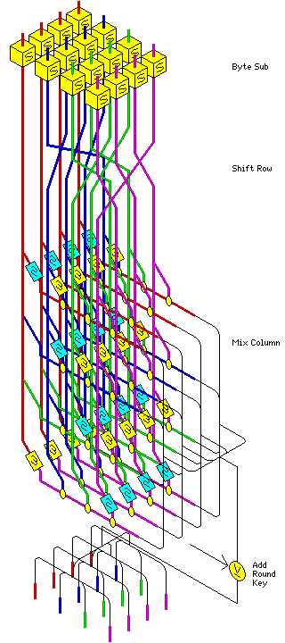
AES: Confusion and diffusion using Math operations
Byte Substitution
Shift row
Mix column
Add around key

Slide 8
Hybrid System

Slide 9
The problems
Only use RSA: too slow
Only use AES: key exchange problem

Slide 10
The main idea of the hybrid system
Encrypt a session key: RSA
Encrypt a document: AES

Slide 11
Scenario: Alice wants to send an encrypted document to Bob
Bob generate a pair of key (public and private)
Bob publish the public key
=================================================
Alice picks a random session key
Alice uses the session key to encrypted document
Alice uses the RSA public-key to encrypt the session key
The encrypted session will be saved to the encrypted doc too
Alice sends the encrypted the doc to Bob
=================================================
Bob will receive encrypted doc
Bob uses AES’s private key to reveal the session key
Bob decrypt encrypted doc using the session key.

Slide 12
Crypt-tool: Encrypt a file

Slide 13
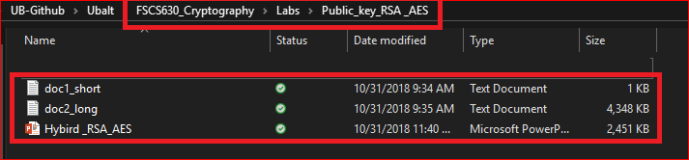
Required files for the lab

Slide 14
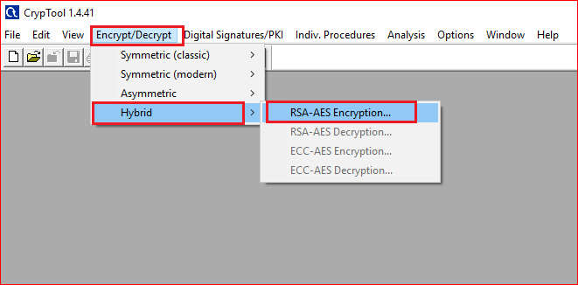

Slide 15
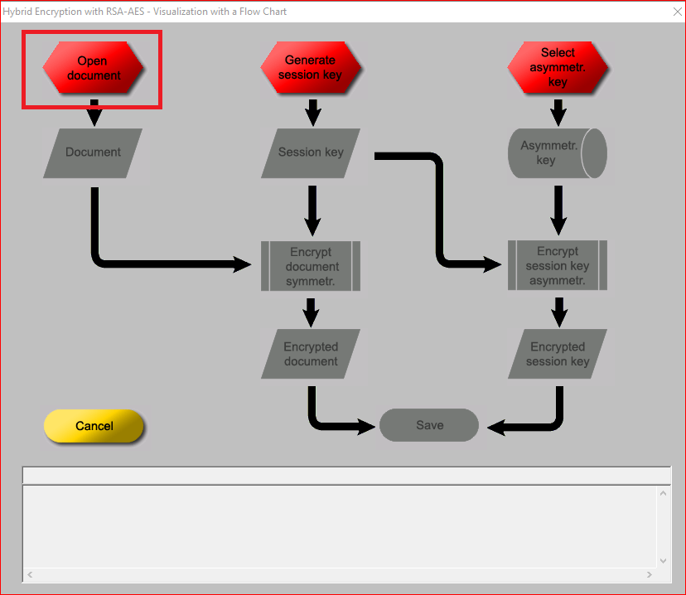
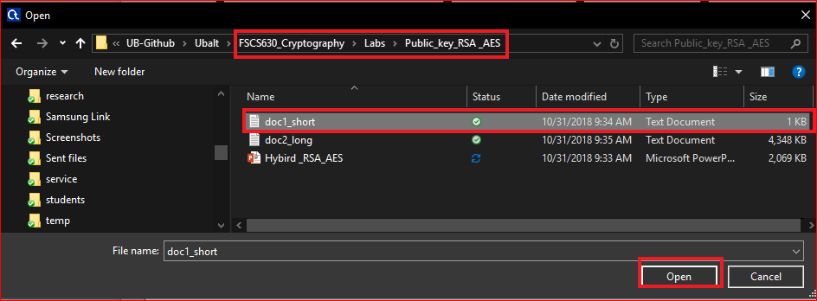

Slide 16
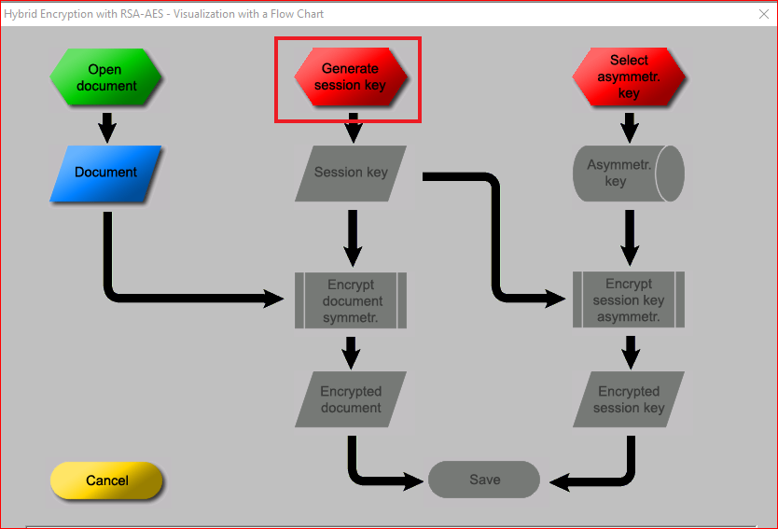
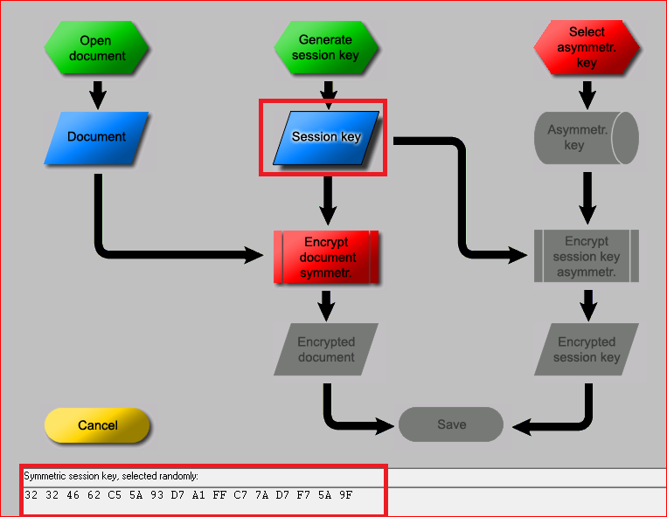

Slide 17
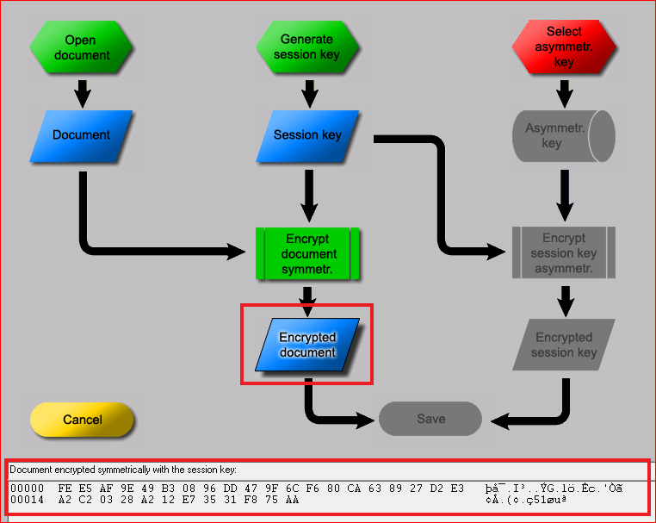
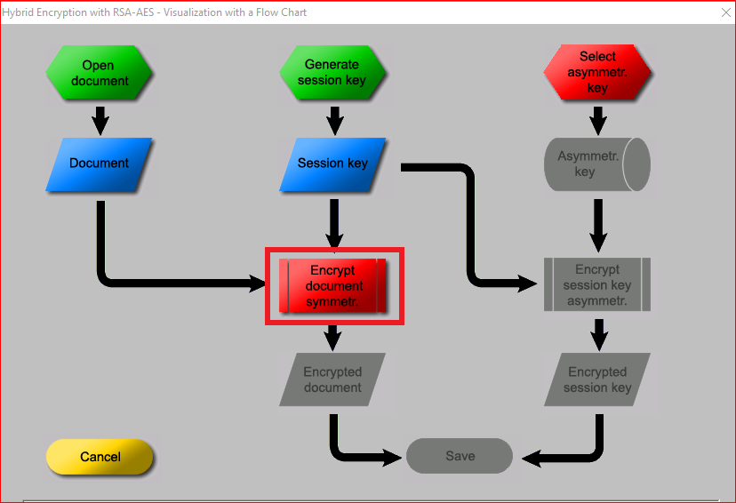

Slide 18
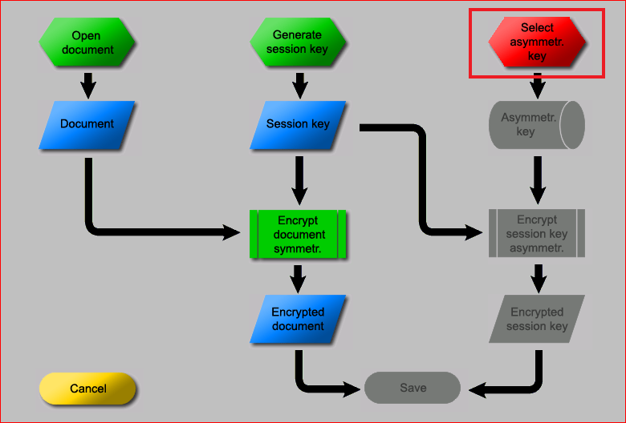
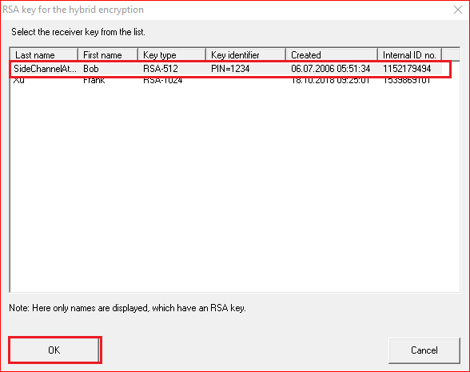

Slide 19
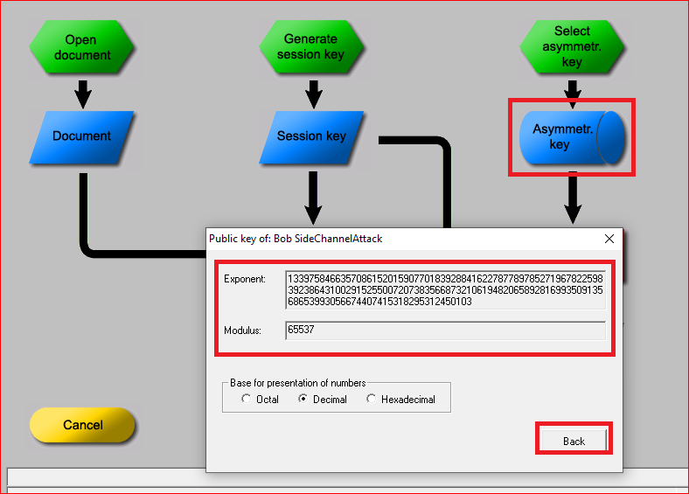

Slide 20
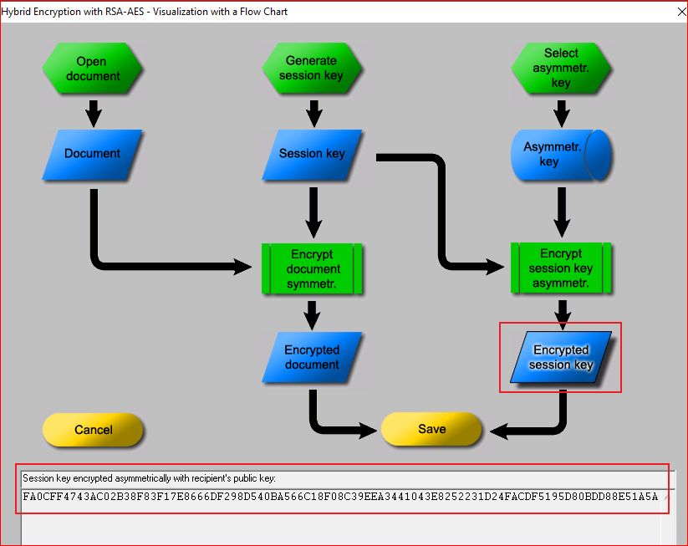
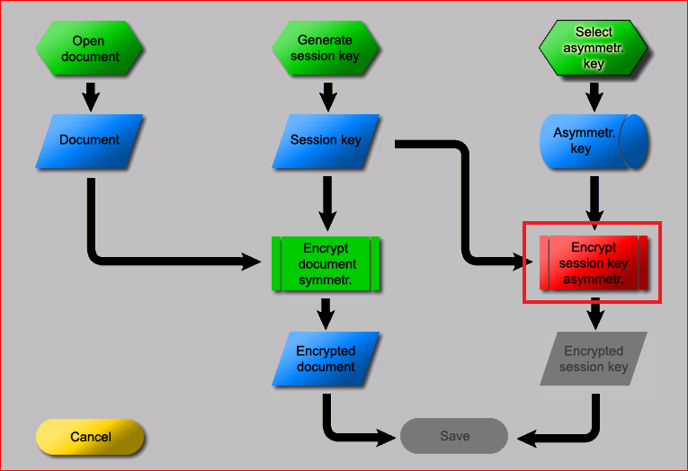
FA0CFF4743AC02B38F83F17E8666DF298D540BA566C18F08C39EEA3441043E8252231D24FACDF5195D80BDD88E51A5A0E9622D0DB26C549769ACBBD3758D9D11

Slide 21
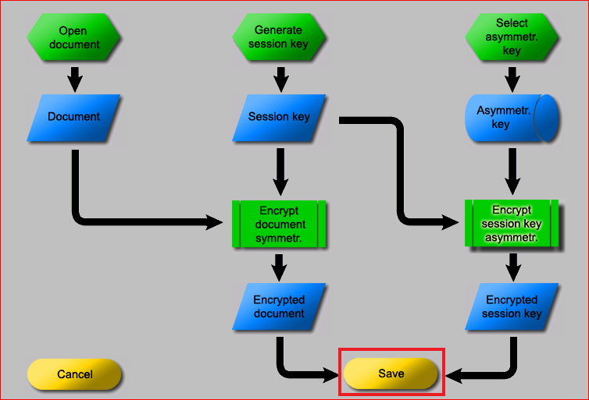
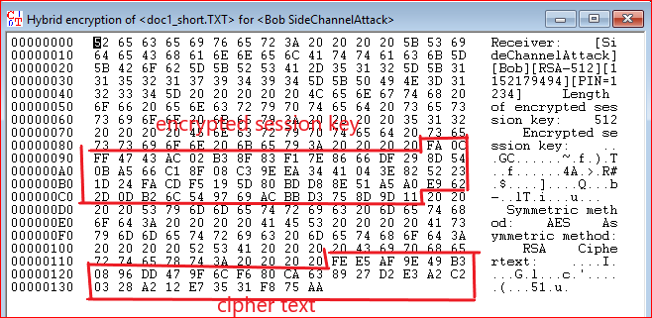

Slide 22
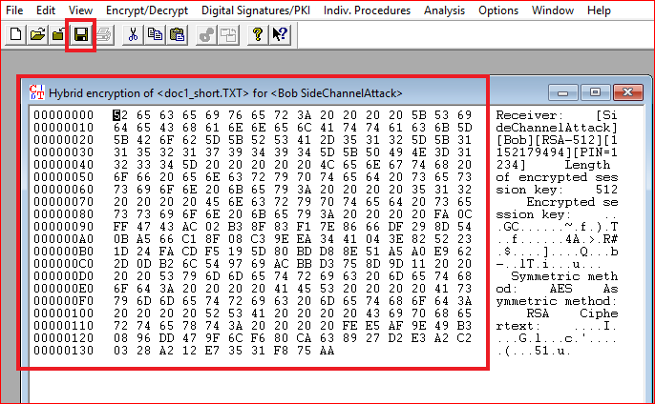
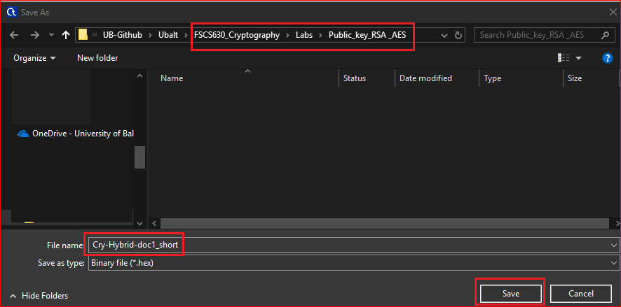

Slide 23
Questions
What is the size of session key in bits?
What is the size of encrypted session key in bits?
What is the size of encrypted text, i.e., “hello RSA and AES”?
What is the size of doc1_short.txt?
What is the size of encrypted file Cry-Hybrid-doc1_short.txt?

Slide 24
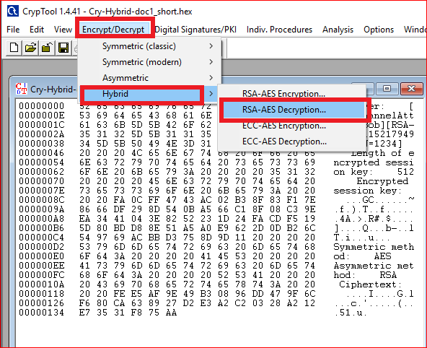
Your work
Decrypt the Cry-Hybrid-do1_short.hex

Slide 25
Your work
Encrypt the doc2_long.txt
Overserve the file size of the original file and encrypted file. Are they different? Why?

